Slide 1
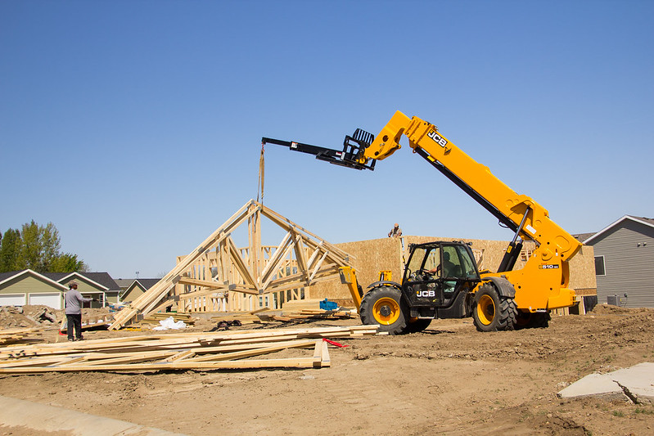
McKenzie Co. Job Development Authority Housing shortage public input meeting March 8, 2023, 10-11:15am CT, McKenzie County Courthouse
TODAY’S AGENDA
Background and review of prior JDA housing programs
Factors already identified regarding why we aren’t seeing more housing construction in McKenzie County
Potential program ideas to mitigate challenges
Feedback
In addition to sharing at today’s meeting, attendees can also submit comments to jsuter@co.mckenzie.nd.us until March 15, 2023
Notes:
Goal is for the meeting to run no more than one hour/one hour 15 min, but also provide ample time for feedback from attendees

Slide 2
Why housing?
Consistently cited as one of our top impediments to economic growth
The housing shortage is a national issue, but it is amplified in the Bakken due to the availability of materials and labor and our population growth
From 1976 through 1979, 418,000 entry-level single-family houses/year were built, 34% of all new homes constructed. In the 1980s, the number fell to 314,000/year, still 33% of all new homes built. In the 1990s it shrank to just 207,000/year, and in the 2010s about 150,000/year. During the just completed 2010s, starter homes averaged just 55,000/year, or just 7% of new residential construction. Yikes!
-Elliot F. Eisenberg, Ph.D. Economist
State and Federal housing programs have been inadequate to meet McKenzie County’s unique needs to address the issue

Slide 3
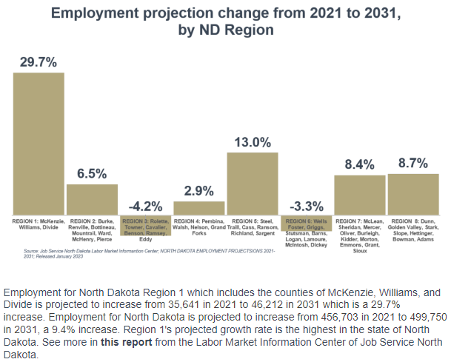
Today we have insufficient housing inventory – look forward to 2031
Source: McKenzie Co 1.2023 newsletter:
https://myemail.constantcontact.com/Watford-City---McKenzie-County-January-2023-update.html?soid=1127745239162&aid=tp-7VJFByM4

Slide 4
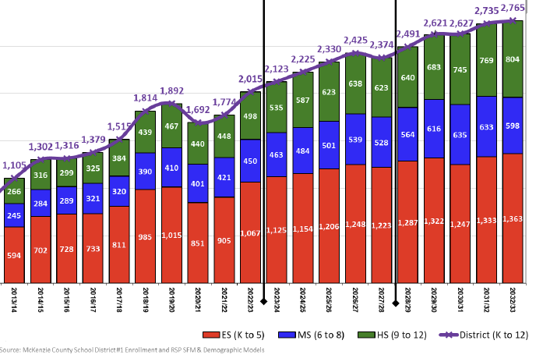
Today we have insufficient housing inventory – RSP cites rebound of housing as district enrollment determining factor (50 units / year)
Source:
MCSD #1 Enrollment Analysis – February 2023
https://econdev.mckenziecounty.net/wp-content/uploads/McKenzie-CountyEA-Jan2023update.pdf

Slide 5
MC Housing statistics
WC Planning reported 3/3/2023: 0 permits pulled for 2023 construction season
Same time period in 2022: 4 permits pulled for 2022 construction season
0 for McKenzie County/Alexander/Arnegard thus far in 2023.
Data Sources: WC Planning Department
MC Planning and Zoning Department
Alexander Auditor’s Office
Arnegard Auditor’s Office

Slide 6
Prior JDA Housing Programs
Housing development subsidy program
Shovel-ready lot program

Slide 7
Housing Development Subsidy program
Stick-built (on- or off-site), 3 bedroom, 2 bath, 2 car attached garage, single-family house; Lot sized 1 acre or less for city; 2 acres or less in county
Price of house was capped at the FHA max price + subsidy amount
2019 FHA max was $317,700; 2020 FHA max was $331,760
2021 FHA max was $356,362; 2022 FHA max was $420,680
Up to $50,000 for house with complete infrastructure or up to $25,000 for house with limited infrastructure
Homebuyer must live in house for 5 years
Complete program information available at: https://econdev.mckenziecounty.net/grants-incentives/housing-subsidy-program/
Notes:
complete infrastructure: curb, gutter, sidewalk, municipal water/sewer
limited infrastructure: municipal water/sewer in city; or approved county subdivision with improved gravel road and septic

Slide 8
JDA Housing Development Subsidy Final Stats
Program launched: June 2019
First program house sold: Dec 2019
Final program house sold: June 2022
45 single-family houses built
$17,492,133 actual sales price
~$102,500 in annual real estate taxes (2022)
$274,074 one-time building permit fees
$2,000,000 total subsidy provided
4 Subdivisions:
Flickertail Fields- 10 houses
Stepping Stone- 23 houses
Tara Estates- 8 houses
Veeder Estates- 4 houses
35 meetings of the JDA Housing Development Subsidy Committee
Joel Brown, Aaron Weber, John Carns, Curt Moen
8 Builders:
Ascend Building- 1 house
Harr Family Homes- 1 house
KDR Homes- 1 house
KLT Enterprises- 15 houses
LT Development- 1 house
Michael Goulet Inc- 10 houses
Paramount Homes- 14 houses
Premier Homes- 2 houses
This program ended on June 30, 2022, with all $2 million expended. The only administration left is monitoring the 5 year claw back stipulation, or if a homeowner looks to refinance.
Notes:
(building permit fees range from $0-$8722; average $6091) ; approx. $2500 per house in Real Estate taxes for City of WC; approx. $1500 in Real Estate taxes per house for County (Flickertail Fields); City of WC was heavily involved in helping us with the building inspections to make sure our qualifications were met.

Slide 9
Prior JDA Housing Programs
Housing Development Subsidy Program
Shovel-Ready Lot Program

Slide 10
Shovel-Ready Lot Program background
JDA Housing Committee composed of: John Carns, Dia Northrop, Aaron Weber, Joel Brown, Heidi Brenna
Launched February 2020
RFP selection process
Netted $16 million worth of projects from 5 developers
Two awardees (134 total lots) in Spring 2020; awarded based on cost-benefit analysis
Stepping Stone Development $2,536,080
55 lots (32 single family, 10 twin homes, 13 row homes)
Stenehjem Development $2,463,919
79 lots (37 single family and 42 townhome)
Infrastructure completed June 15, 2021
Requirements for developers is that all lots will need to have houses substantially completed by June 15, 2025 (or June 2026 if extension is granted)
13 lots built on thus far
Lot prices capped between $40K-$50K

Slide 11
Limited Build-out of Shovel-ready Lots
Falls across five categories:
Economic uncertainty;
Material shortages and price increases;
Labor and trade shortages;
Mortgage rate and commercial lending rate increases; and
Non-program lots significantly lowered prices.
Notes:
Economic uncertainty:
COVID-19 caused a lot of economic uncertainty, with many people losing their jobs or having their hours reduced. Others chose to renovate their current residences instead of buying or postponed trading up to newer or larger homes.
North Dakota’s economy is heavily reliant on the oil industry. Overlapping COVID-19, political changes at the federal level and global instability kept oil prices relatively low in recent years.
2. Material shortages and price increases:
It’s no secret that McKenzie County is the end of the materials line even in good times. However, material shortages and the resulting price increases during the COVID years intensified the issue.
Prices have begun to come down and Watford City will have a full lumber yard again this summer.
3. Labor and trade shortages:
Skilled laborers tend to gravitate towards the oil field in good times and leave the area in slower times. Construction trades follow a similar path, though in more recent years, we’ve retained more of these trades regionally. The high cost of travel and housing for out of the region trades makes construction challenging in McKenzie County.
4. Mortgage rate and commercial lending rate increases:
While perhaps not historically high, the recent and rapid rise in lending rates has been a shock to home buyers and a significant hurdle for builders. The uncertainty introduced to the market has caused banking institutions to greatly restrict lending to an already small pool of regional home builders.
5. Non-program lots significantly lowered prices:
While shovel-ready lots were bringing in the required infrastructure, existing inventory lots moved to quickly reduce prices and capture limited builder activity.
Net positive for home construction, but impacted program utilization.

Slide 12
Bridging confidence in housing market through Private / Public partnerships (rooftops are economic development)
PUBLIC
JDA
MC Housing Authority
WC Housing Authority
Alexander EDC
WC EDC
PRIVATE
Lenders
Commercial Home Builders
Home buyers
Notes:
Buxton study – rooftops = commercial and retail development
If people cannot move here or stay here due to lack of housing, economic growth stops

Slide 13
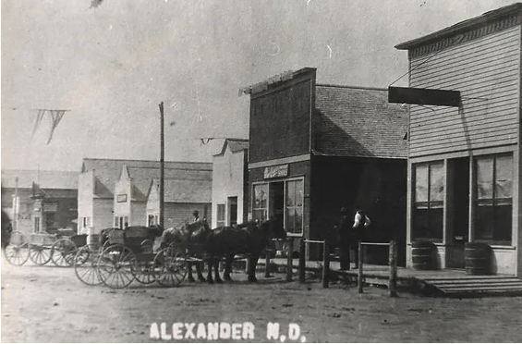
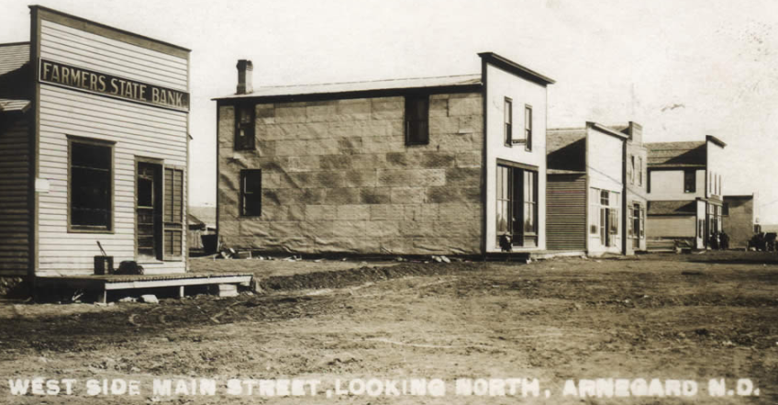
JDA Incentive Concepts to Stimulate Housing Development in MC
Home Builder Participation loan program Operational through the establishment of JDA Economic Development Revolving Loan Fund
JDA Builder Buyback Program
** Private / Public partnerships share risk to strengthen and grow communities **
Notes:
JDA concepts:
Two programs that create a teeter-totter balancing approach for
1 - incentives that spur housings starts and
2 - a backstop for builder and lender risk.

Slide 14
JDA Home Builder Participation Loan Program: $ 4.5 M – RLF – 100% revolving
REVOLVING LOAN FUNDS
Commercial loan participation program for commercial home builders – goal of 6-15 housing units per cycle on builder-controlled, build-ready lots for 3-5 builders. Consider capping / housing unit
($ 650 K if concern of incentivizing McMansions)
Specific to construction lines of credit
For building permanent, single-family, twin, and row homes in McKenzie County
Participate up to 1:1 with local lead lender
Cap. participation at $ 1.5 M per commercial home builder and 1% interest
Participation agreement with pro rata lien position
Lead lender presents loan proposal and participation request to MC Housing committee:
JDA Housing Subcommittee (4-5 JDA members), 1 MC Housing Authority rep, 1 WC Housing Authority rep, and 1 WC EDC rep.
Lead lender administers loan participation according to participation agreement and receives administrative fee for services
Notes:
Incentivize 3-5 commercial home builders to build homes in McKenzie County to get back on track to pre-Covid momentum that the first two programs started
Share risk and create scales of efficiency to impact affordability of new construction

Slide 15
JDA Buyback Program: $ 3.5 M - 85% revolving : 15% grant
RISK MANAGEMENT collateralized purchasing program – carrying capacity insurance program
Home Builder Participation loan program builders submit sites and blueprints to MC Housing committee for enrollment
Cap. program participation at:
3 homes for over $ 3M - $ 2M LOC
2 homes for $ 2M - $ 1M LOC
1 home for $1M or under LOC
Construct and, 180 days post Cert. of Occupancy, builder can request JDA buyback at LOWER OF:
Reimbursable receipts
OR
90% of appraised value
Cap. of $500,000 buyback on a housing unit
Notes:
The program is like any insurance policy. The intent is not to use it, but it is available if needed
It is primarily a revolving fund program, but will contain certain leakage / one way outflow of funds that will deplete over time if the program is needed
Included caps on the concept with back worked matrix that keeps the marble in play between the two ends of the teeter-totter

Slide 16
To establish market confidence, MC needs an inventory of homes that:
Have realized value
Have a variety of amenities, features, and finishes
Have qualities that fit market demands
Have a mixture of price points
Are in multiple locations throughout the County
Notes:
Too many stories of people:
NOT RELOCATING here
LEAVING here
due to housing solutions that don’t meet their needs.
Once we lose their attention / lose their interest / lose them, we don’t get a second chance for them to consider MC as the place they will make a long term housing investment.

Slide 17
Permanent Housing ROI – Property tax
Added Property Tax Value at 50 housing units / year to absorb the additional workforce (expected to grow by 30% over the next decade) – IMPACT ON TAX COLLECTIONS without LEVY or INFLATION increases:
Year 1: $ 100,000
Year 2: $ 200,000
Year 3: $ 300,000
Year 4: $ 400,000
Year 5: $ 500,000
Year 6: $ 600,000
Year 7: $ 700,000
Year 8: $ 800,000
Year 9: $ 900,000
Year 10: $ 1,000,000 ………….. Years 11 - 50: $1,000,000
$ 45.5 M in property tax collections over the life of the investment
Source: Estimate from MC Tax Equalization / Recorders office
Notes:
Using an average COUNTY new construction housing value of $ 400,000
Using current average mill levy that generates an average of $2,000 / housing unit
Using 50 new housing units / year for the next 10 years (which is half of the needed units according to the JSND statistics for employment growth over the next decade)
827% ROI

Slide 18
Permanent Housing ROI – sales tax
Estimates calculated using $300K in materials per home
50 homes / year for ten years
Local sales tax rate of 1.5%
Year 1: $ 225,000
Year 2: $ 225,000
Year 3: $ 225,000
Year 4: $ 225,000
Year 5: $ 225,000
Year 6: $ 225,000
Year 7: $ 225,000
Year 8: $ 225,000
Year 9: $ 225,000
Year 10: $ 225,000
$ 2.250 M in local sales tax collections over life of investment
Notes:
Assuming point of sale is through the local lumber yard

Slide 19
Permanent Housing ROI - indirect
Increase in MC GDP by ability to attract needed workers by 20% (2022 GDP):
$ 4,492,000,000 x .2 =
$ 898.4 M annually
Indirect commerce / disposable incomes annually (additional 500 family units living in MC with median household incomes of $ 79,000):
500 x $79,000 = $ 39.5 M annually
Notes:
AFFORDABILITY for median household income
$15,000 down
30-yr fixed at 7.3%
$ 280,000 purchase price
AFFORDABILITY for workover floor hand and child care provider of $ 100,000 + $ 35,000 = $ 135,000
$ 15,000 down
30-yr fixed at 7.24%
$ 464,000 purchase price
AFFORDABILITY for two teachers of $ 65,000 + $ 70,000 = $ 135,000
$ 30,000 down
30-yr fixed at 7.27%
$ 484,600 purchase price

Slide 20
For more information and to submit written comments by March 15
https://econdev.mckenziecounty.net/housing-mtg/
Email: Jsuter@co.mckenzie.nd.us

